Slide 1
ECONOMIC ANALYSIS AND OPTIMAL OPERATION OF PUMPED STORAGE HYDRO IN DAY AHEAD MARKET
Presenter | Supervisors
Ashish Bhatta Graduate Student MEPE 2020 Batch | Assistant Professor Dr. Kamal Chapagain (DOEEE Kathmandu University) and Dr. Sushil Aryal (Nepal Electricity Authority)
THESIS DEFENSE
Date:19 November 2025
Notes:
Title Slide [Fixed Format]
Just change the EVENT and DATE

Slide 2
Outline
Background
Research gap
Objectives
Methodology
Results and discussion
Conclusion
Future recommendation

Slide 3
Energy Security

Slide 4

Electricity Security in Nepal’s Context

Slide 5

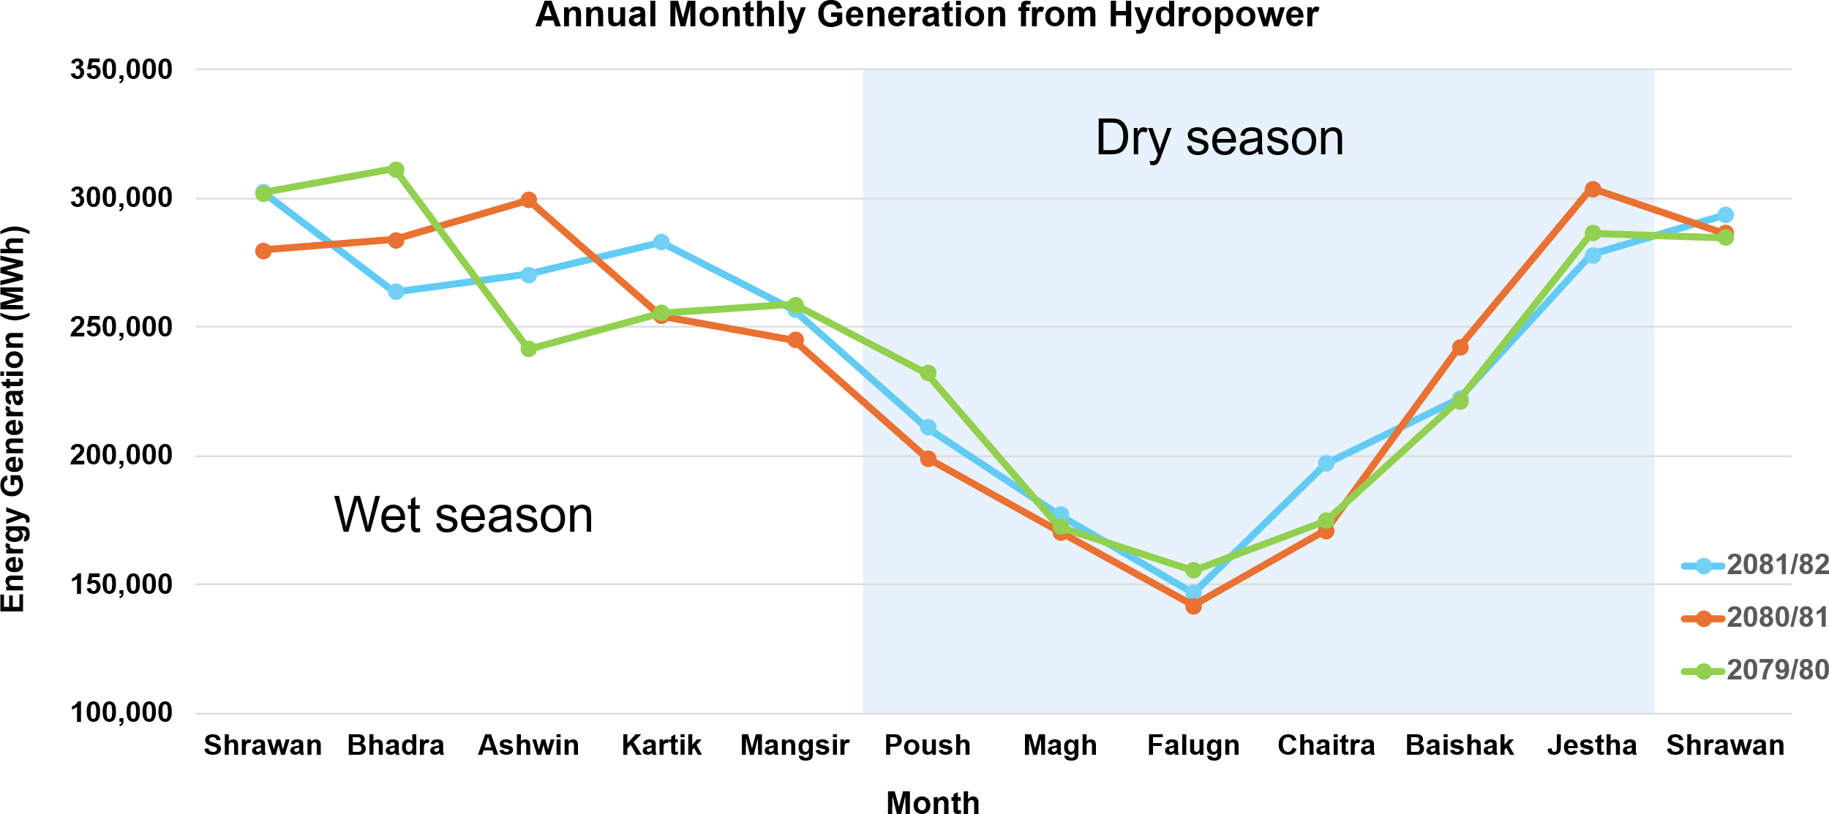
Seasonal Variation in Electricity Production
FIGURE 1: Seasonal Variation in Electricity Production [1]
Notes:
Intermediate Slides [Flexible Format] [Format in Similar Manner]

Slide 6
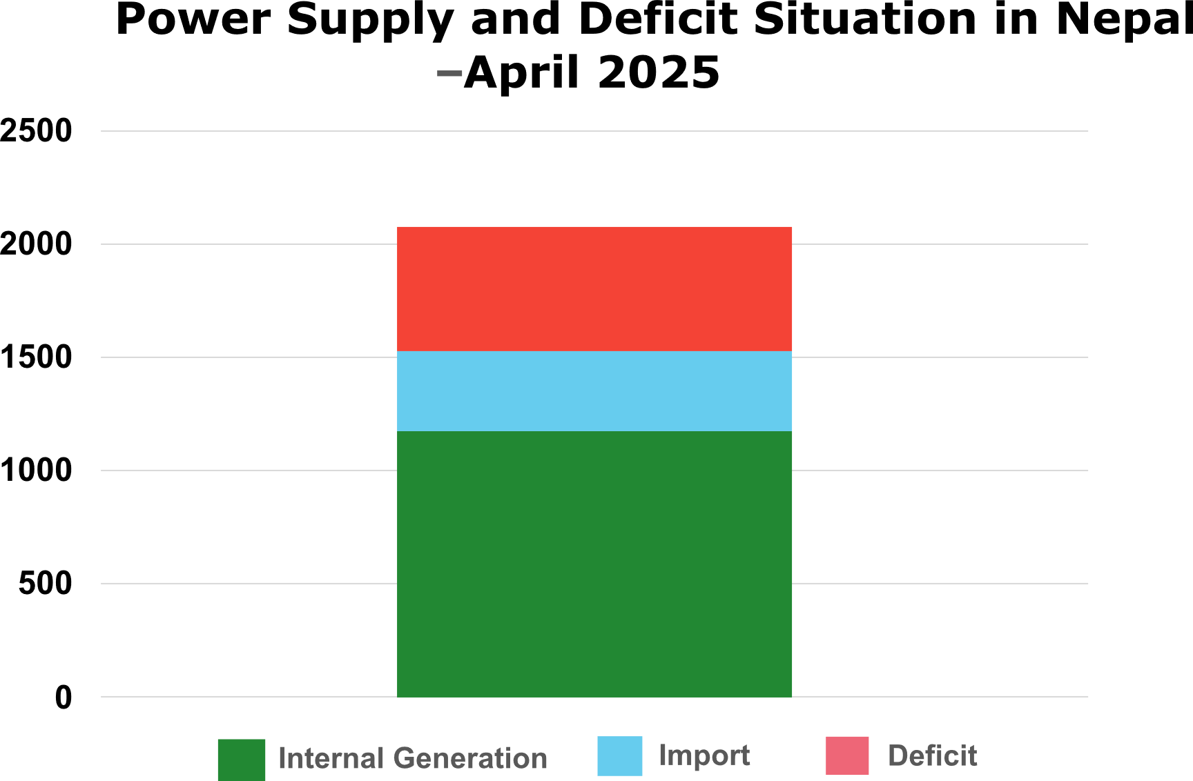
Energy Deficit in Dry Season
FIGURE 2 : Electricity Demand and Supply for April 2025 ¹
¹ https://nepsetrading.com/blog/nepals-power-sector-struggles-amid-dry-season-india-nepal-expand-energy-cooperation
Notes:
Intermediate Slides [Flexible Format] [Format in Similar Manner]

Slide 7
Pumped Storage Hydro and Energy Security in Nepal

Slide 8
Pumped Storage Hydro Working Principle
When electricity is cheap
Water is pumped from lower reservoir to upper reservoir
upper Reservoir
Lower Reservoir
Pumping Cost = pump power * pumping duration * unit energy cost
Pump / Turbine set

Slide 9
Pumped Storage Hydro Working Principle
When electricity is expensive
Water is discharged from upper reservoir to lower reservoir
upper Reservoir
Lower Reservoir
Generation Cost = Generator power * Generation duration * unit energy cost
Pump / Turbine set

Slide 10
Revenue from Energy Arbitrage
Revenue from energy arbitrage
=
Cost for electricity sold
-
Cost of electricity for pumping

Slide 11
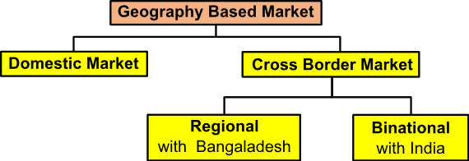
Energy Arbitrage Possibilities
Nepal can participate in energy arbitrage in domestic market and cross border market through IEX Day ahead market
Wet season : Energy arbitrage with India
Dry season : Energy arbitrage in domestic market

Slide 12
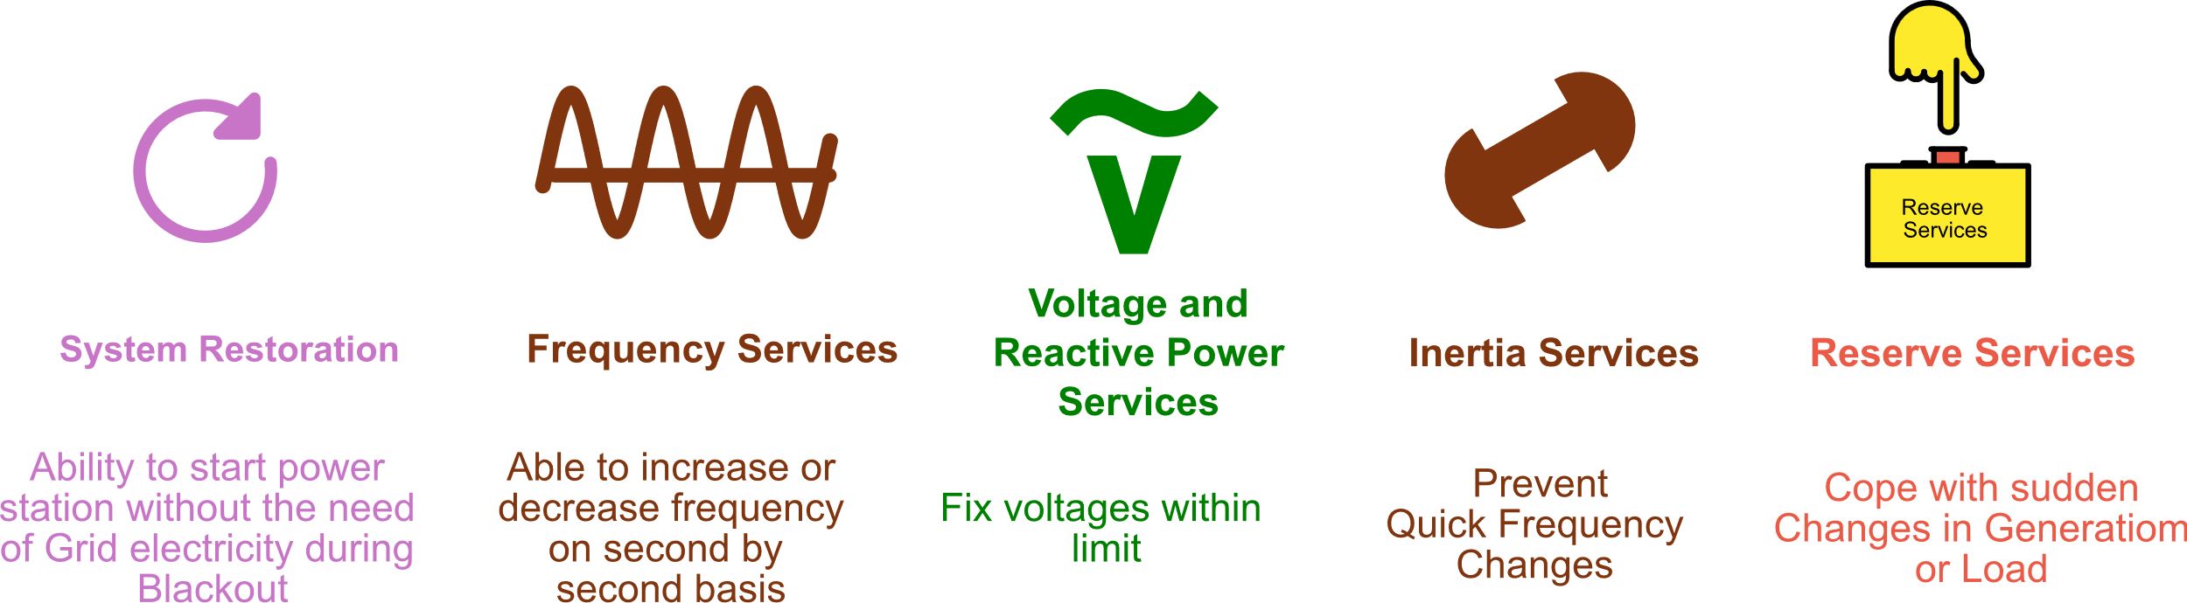
Revenue From Ancillary Market
Currently there is no Ancillary market in Nepal
Possibility for selling ancillary services with other country in future

Slide 13
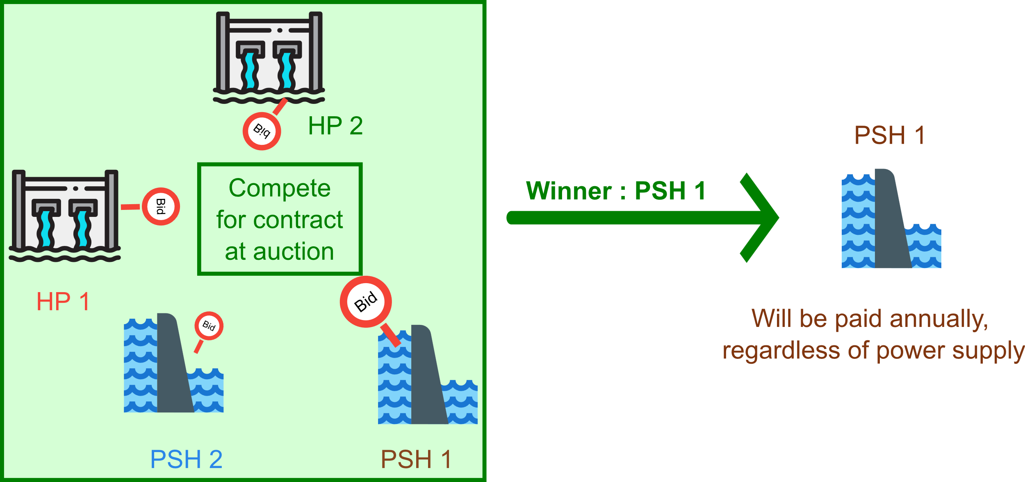
Revenue From Capacity Market
Currently there is no Capacity market in Nepal

Slide 14
Problem Statement
Seasonal variation led to increased concern on energy security of country
Lack of incentives for the development of pumped storage hydro
But high investment cost,
Lack of incentives
Need for Supporting the Development of Pumped Storage Hydropower in Nepal
Exploration of various revenue stream
Tariff mechanism for pumped storage hydro
Integrated energy development plant

Slide 15
Objectives
General objective
The primary objective of this study is to perform economic analysis of a pumped storage and develop an optimum bidding strategy for pumped storage hydro in the competitive day-ahead electricity market.
Specific objectives
Identify various CAPEX cost of a pumped storage hydro.
Determine the LCOE of a pumped storage hydro.
Determine optimal bidding strategy of a pumped storage plant in the day-ahead market.
Apply the identified CAPEX, LCOE evaluation, and optimal scheduling analysis to the proposed Kulekhani–Sisneri pumped-storage as a case study.

Slide 16
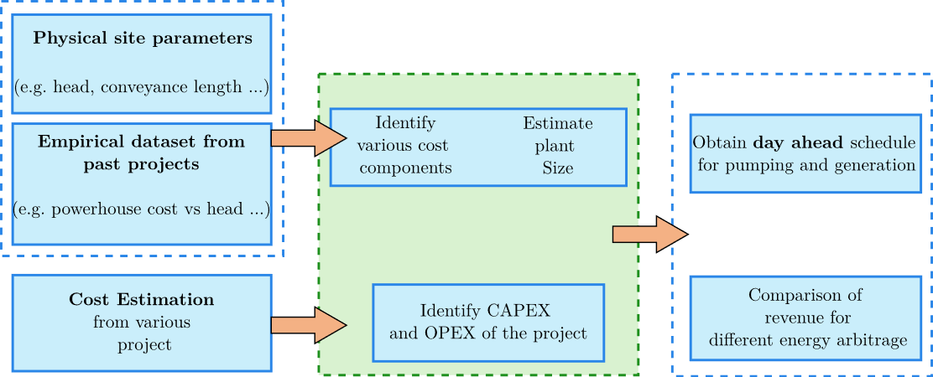
METHODOLOGY
Economic Analysis
Optimum scheduling
FIGURE 4 : Overall Methodology

Slide 17
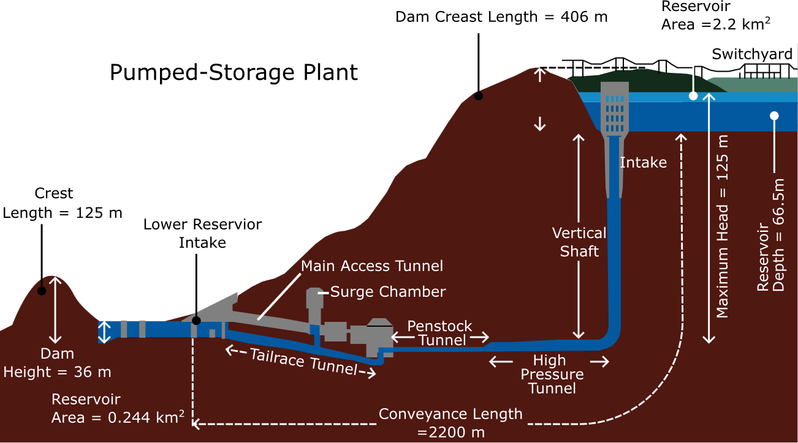
Input 1 : Physical Site Parameters

Slide 18
Input 2 : Empirical Data Sets
Several assumptions and data are taken from
Electric Power Research Institute (EPRI) Pumped Storage Planning and Evaluation Guide (EPRI 1990)
HDR Inc consultant
Small Hydro Consulting

Slide 19
Input 3 : Cost Estimation From Literatures
Cost Estimation of three different Pumped hydro project of different size is taken for analysis
Reference 1 :
Reference 2 :
337 MW project in Australia
500 MW project in USA
Reference 3 :
116 MW project in USA

Slide 20
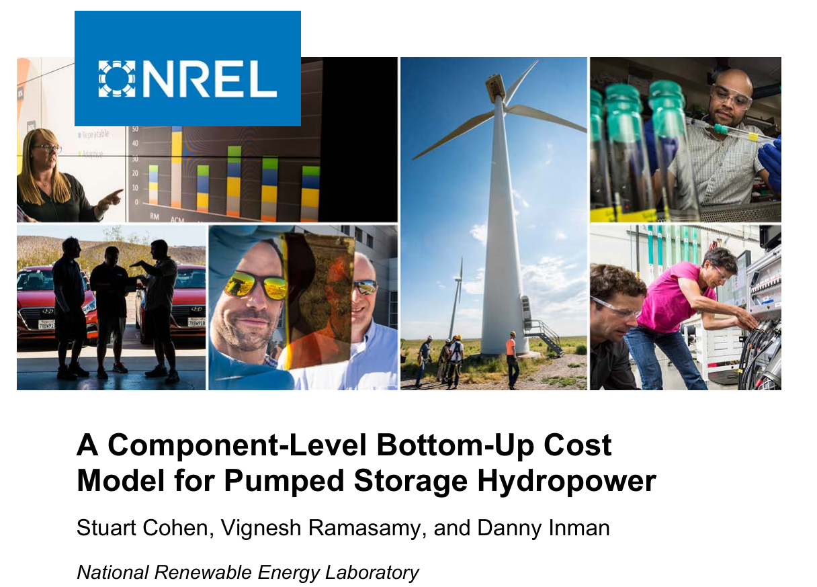
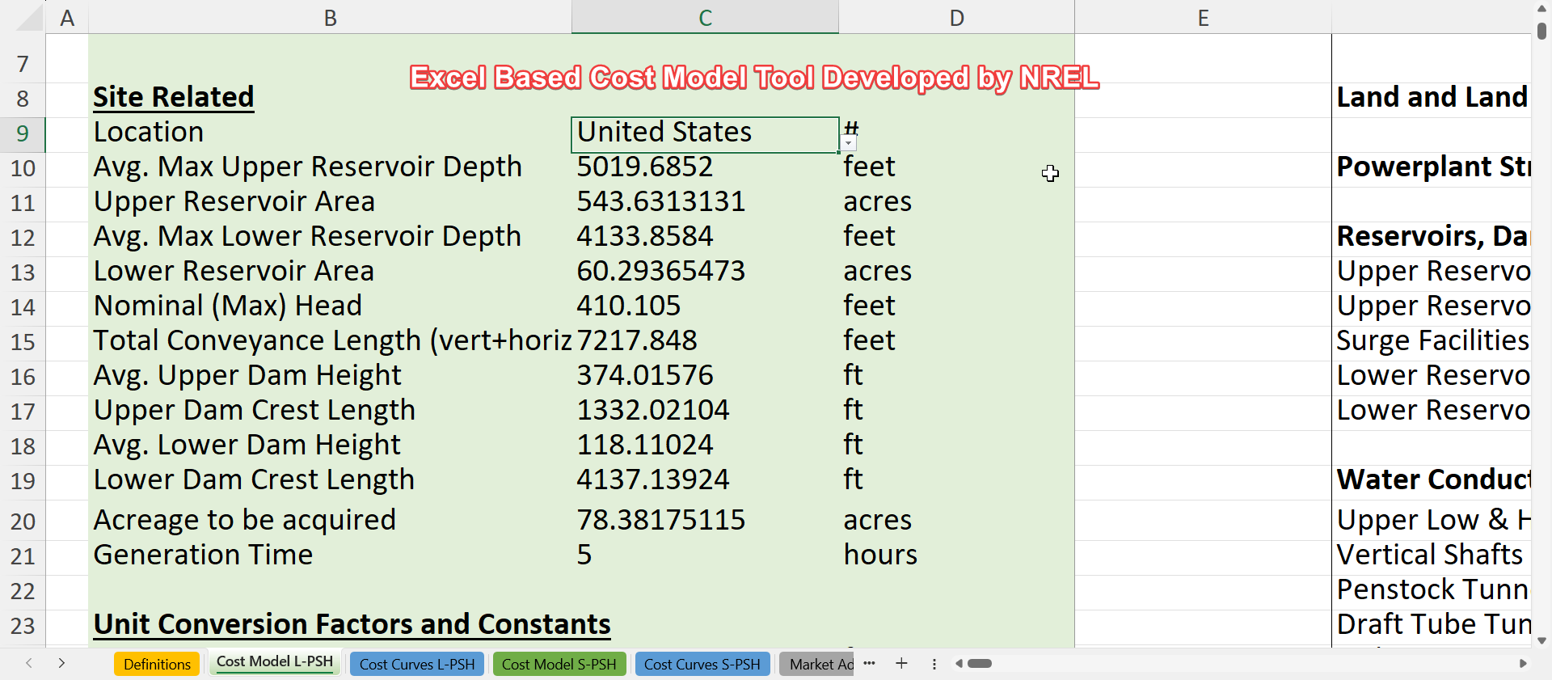
Excel Based Cost Modelling Tool

Slide 21
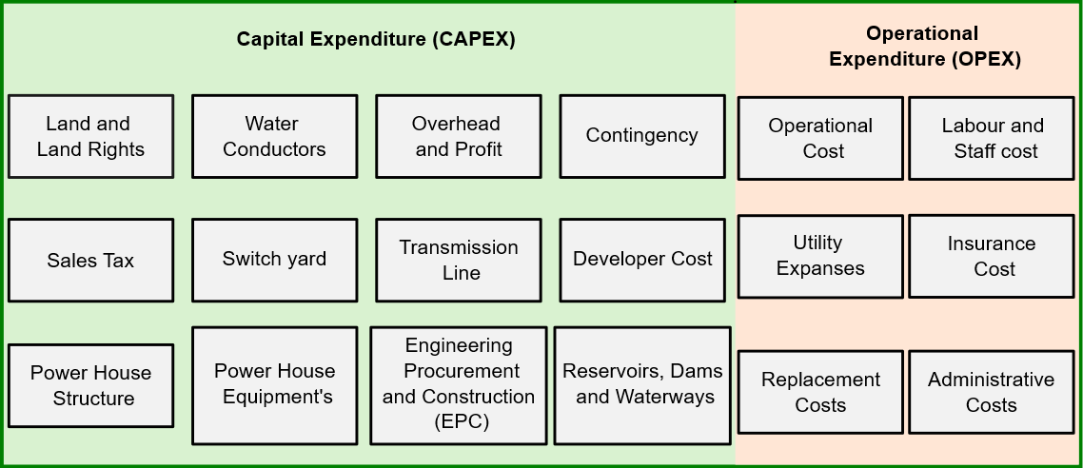
CAPEX and OPEX Components of a Project

Slide 22
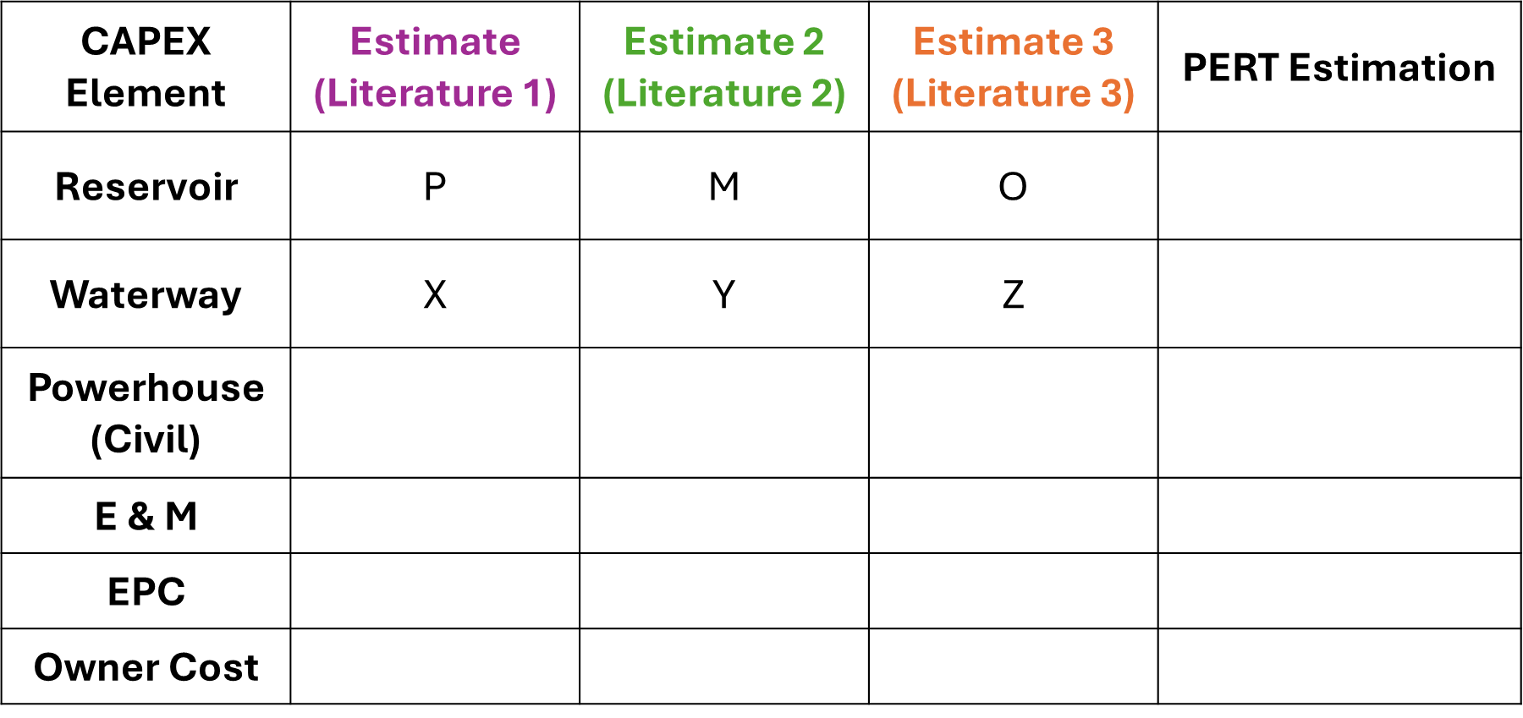
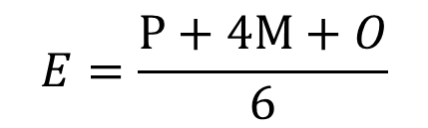
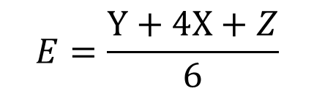
CAPEX Estimation using PERT Technique
CAPEX estimation is performed using stochastic three-point approach
CAPEX Element | Estimate (Literature 1) | Estimate 2 (Literature 2) | Estimate 3 (Literature 3) | PERT Estimation
Reservoir | P | M | O | $$E=\frac{A+4B+C}{6}$$
Waterway | X | Y | Z | $$E=\frac{P+4M+O}{6}$$
Powerhouse (Civil)
E & M
EPC
Owner Cost
$$E=\frac{P+4M+O}{6}$$
$$E=\frac{Y+4X+Z}{6}$$

Slide 23
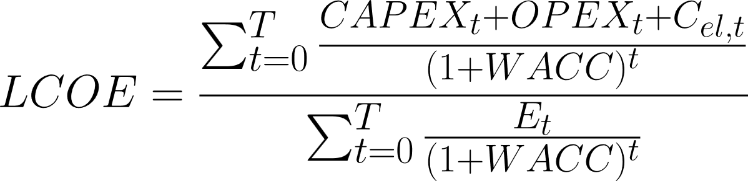
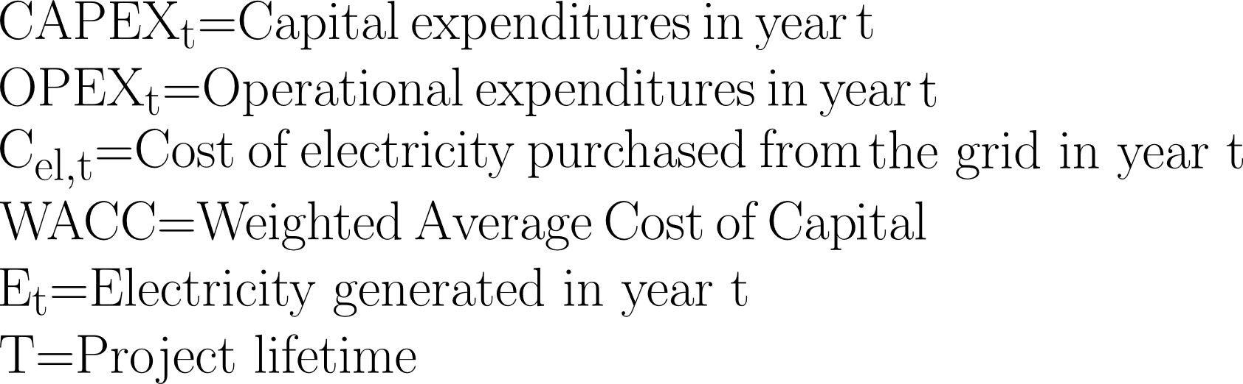
LCOE Calculation

Slide 24
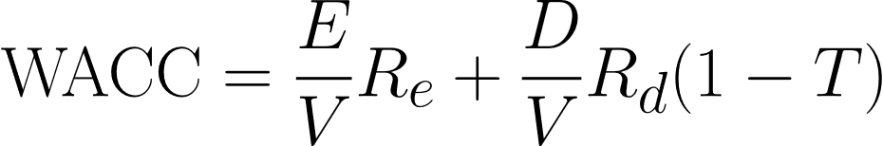
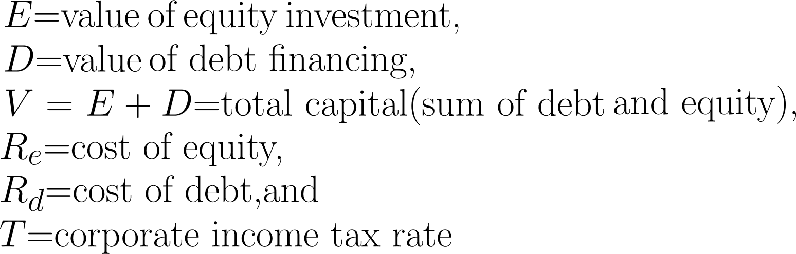
LCOE Calculation

Slide 25
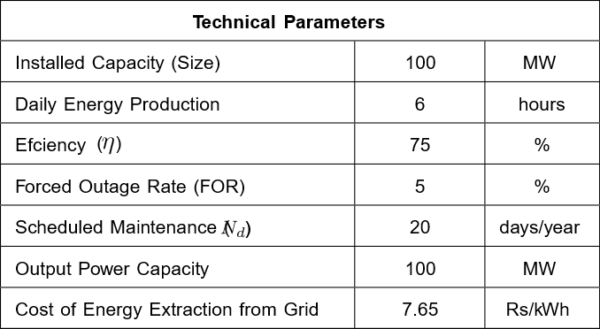
Parameters for LCOE Calculation

Slide 26
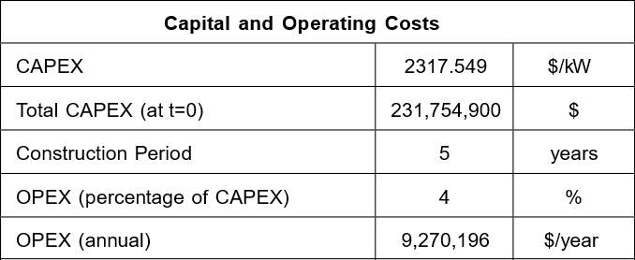
Parameters for LCOE
CAPEX estimated before are taken as a reference

Slide 27
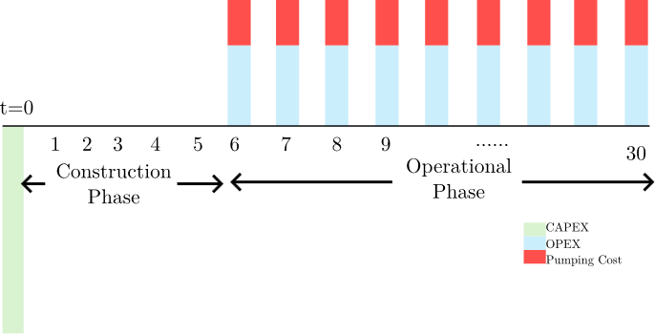
Parameters for LCOE Calculations

Slide 28
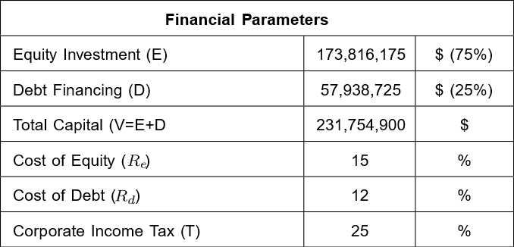
Parameters for LCOE
Financial parameters for Nepali projects are taken as a reference

Slide 29
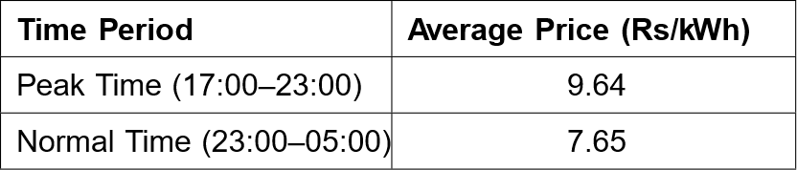
Energy Arbitrage for Dry Season
Wet season : Energy arbitrage with India
Dry season : Energy arbitrage in domestic market
Average prices in Dry Season

Slide 30
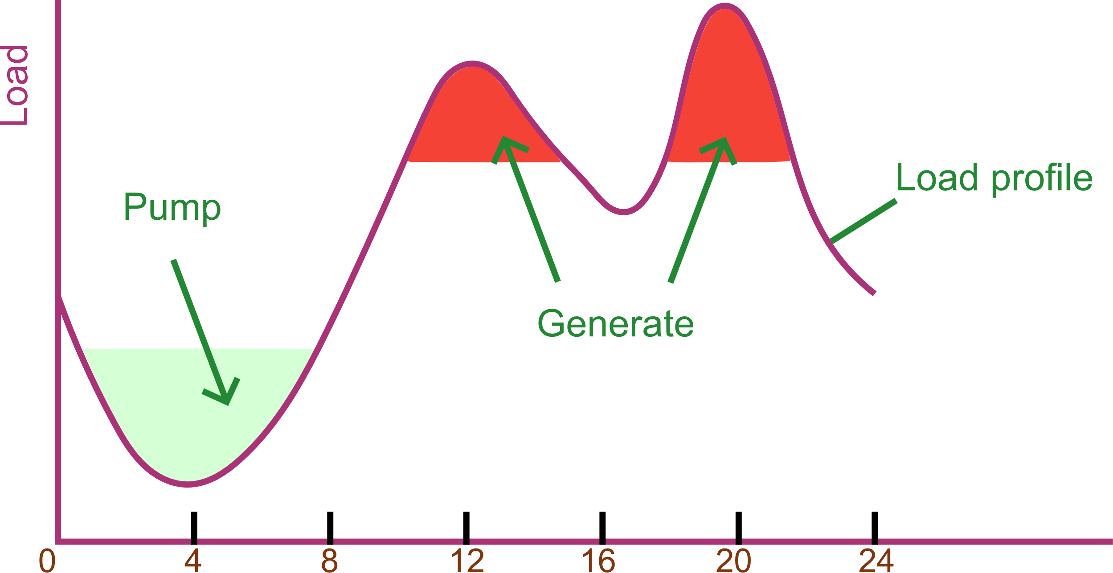
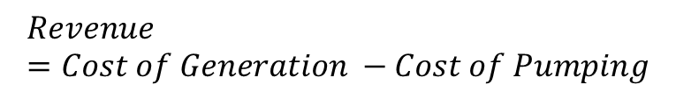
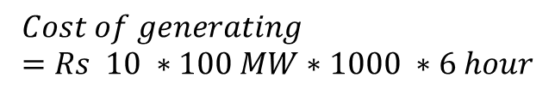
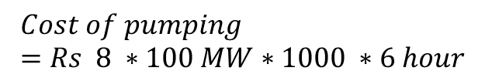
Energy Arbitrage in Regulated Market
$$Cost of pumping=Rs 8 ∗100 MW∗1000 ∗6 hour$$
$$Cost of generating=Rs 10 ∗100 MW∗1000 ∗6 hour$$
$$Revenue=Cost of Generation −Cost of Pumping$$

Slide 31
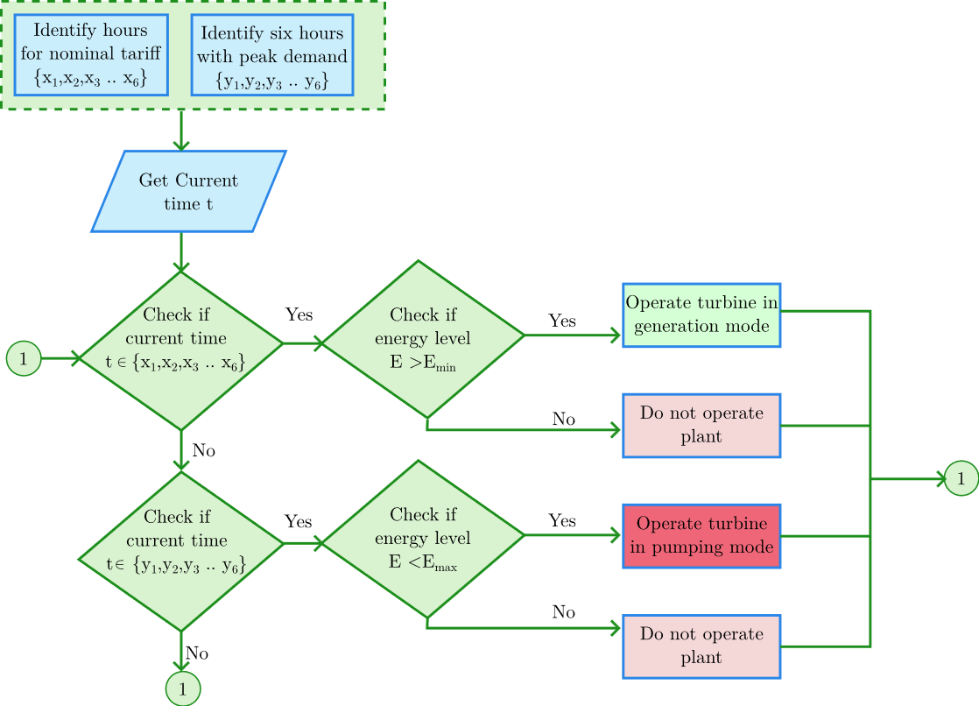
Flowchart For Arbitrage in Regulated Market
FIGURE 5: Energy arbitrage in regulated market

Slide 32
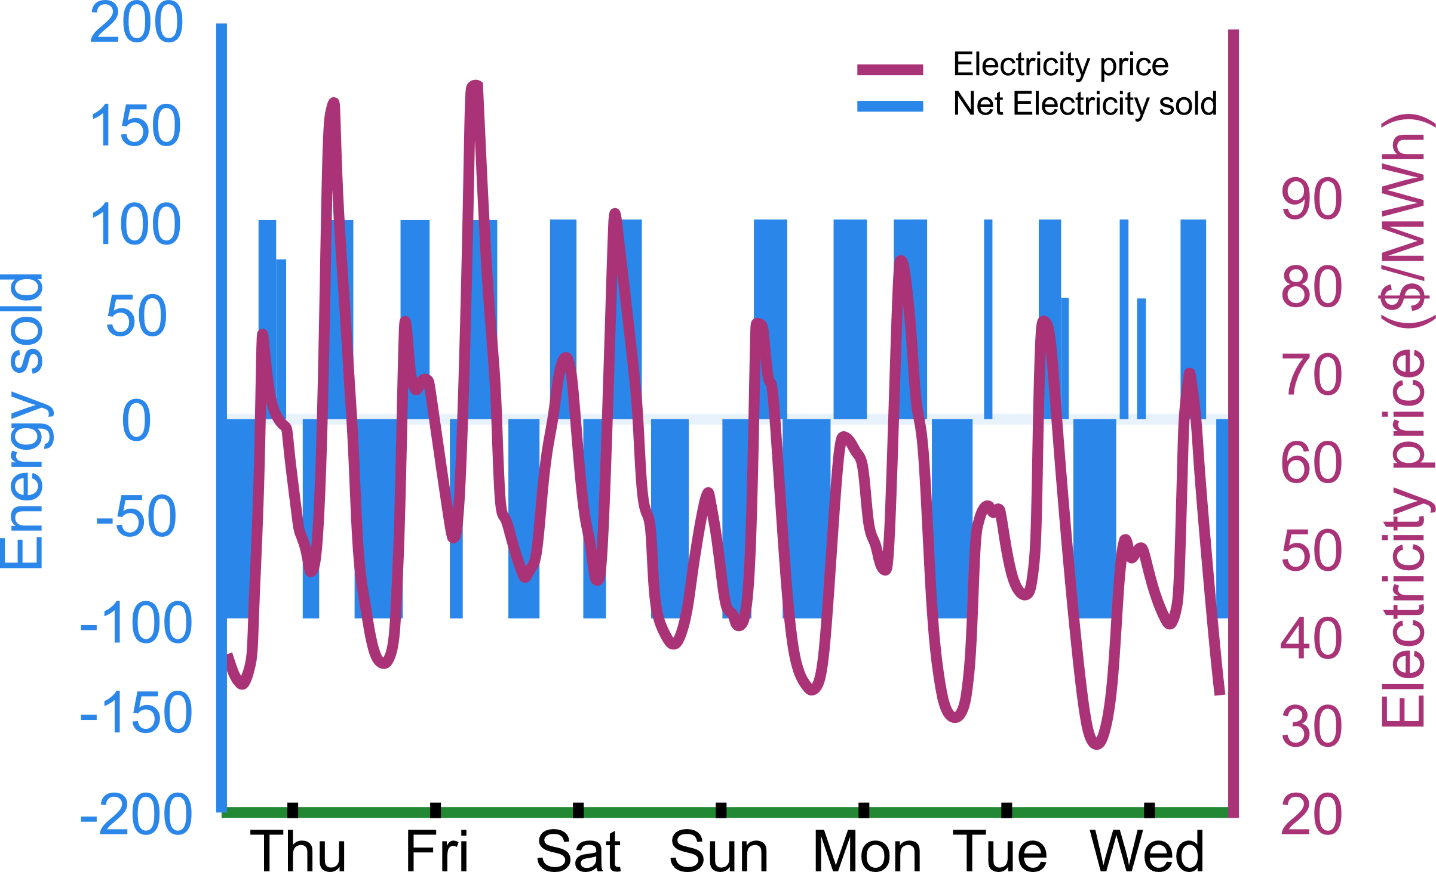
Energy Arbitrage in Competitive Day Ahead Market
1. Prices in competitive market changes every few minutes

Slide 33
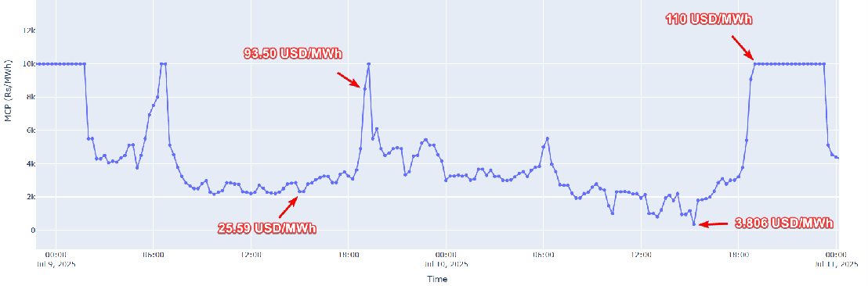
Energy Arbitrage in Competitive Day Market
2. Prices at each hour is not fixed
FIGURE 6 : IEX market clearing price for July 9 and July 10 2025

Slide 34
Energy Arbitrage in Competitive Day Ahead Market
Pumped storage can change market clearing price
MCP = 65 $/MWh
MCV = 32 MWh
Revenue at slot t = 32 * 65 = $ 2080
Maximum power = 100 MWh
PSH discharge bid = 32 MWh at 0 $/MWh

Slide 35
Energy Arbitrage in Competitive Day Ahead Market
When the PSH discharge bid = 82 MWh at 0 $/MWh
MCP = 46 $/MWh
MCV = 82 MWh
Maximum power = 100 MWh
Revenue = 46 $/MWh * 82 MWh =$ 3772

Slide 36
Energy Arbitrage in Competitive Day Ahead Market
When the PSH discharge bid = 100 MWh at 0 $/MWh
MCP = 15 $/MWh
MCV = 100 MWh
Maximum power = 100 MWh
Revenue = 100 MWh * 15 $/MW = $ 1500

Slide 37
Energy Arbitrage in Regulated and Deregulated Market
 | Arbitrage in Regulated market | Arbitrage in Day Ahead Market
Price | Fixed price | varies significantly each hour
Arbitrage Strategy | Simple strategy | More complex strategy
Price Elasticity | Prices not responsible to weather, demand, holiday | Prices changes according to weather, demand, holiday
Scheduling | Easy | Need detail market analysis

Slide 38
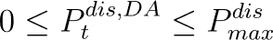
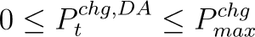
Optimum Scheduling in Day Ahead Market
Optimum scheduling of a pumped storage hydro in DA market can by formulating and solving the optimization problem.
Objective Function is to
Maximize the revenue
Constraints

Slide 39
Optimum Scheduling in Day Ahead Market
Market
Clearing
Price
forecasted DA price
Obtained form past market data
Decision Variable
Optimization Problem:
Quadratic, and Convex
Can be solved in using quadprog function in Matlab

Slide 40
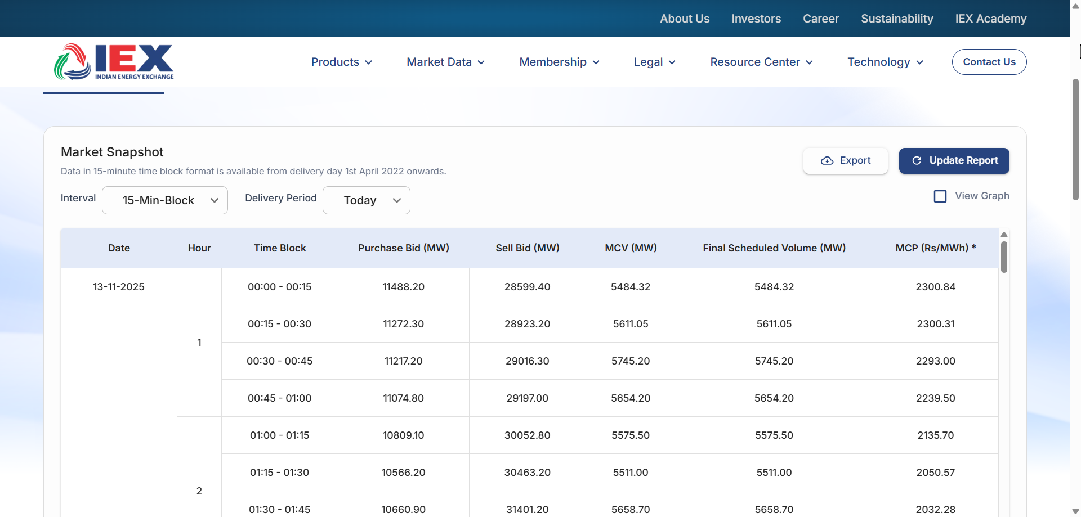
Optimum Scheduling in Day Ahead Market
Past Data are obtained from IEX Website

Slide 41
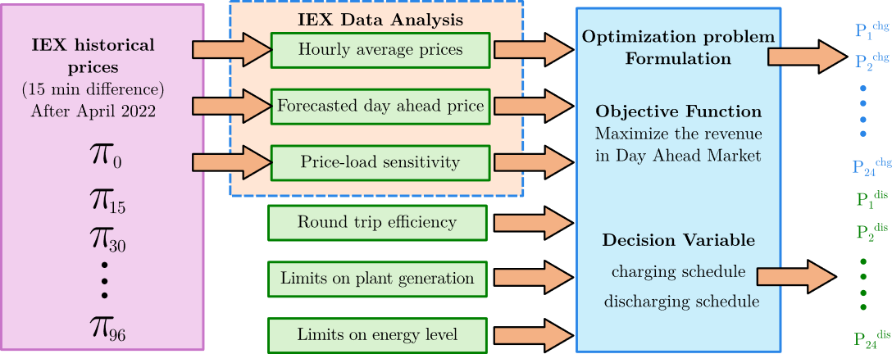
Optimum Scheduling in Day Ahead Market Steps
FIGURE 6 : Finding optimum schedule for Pumped storage hydro from day ahead market

Slide 42
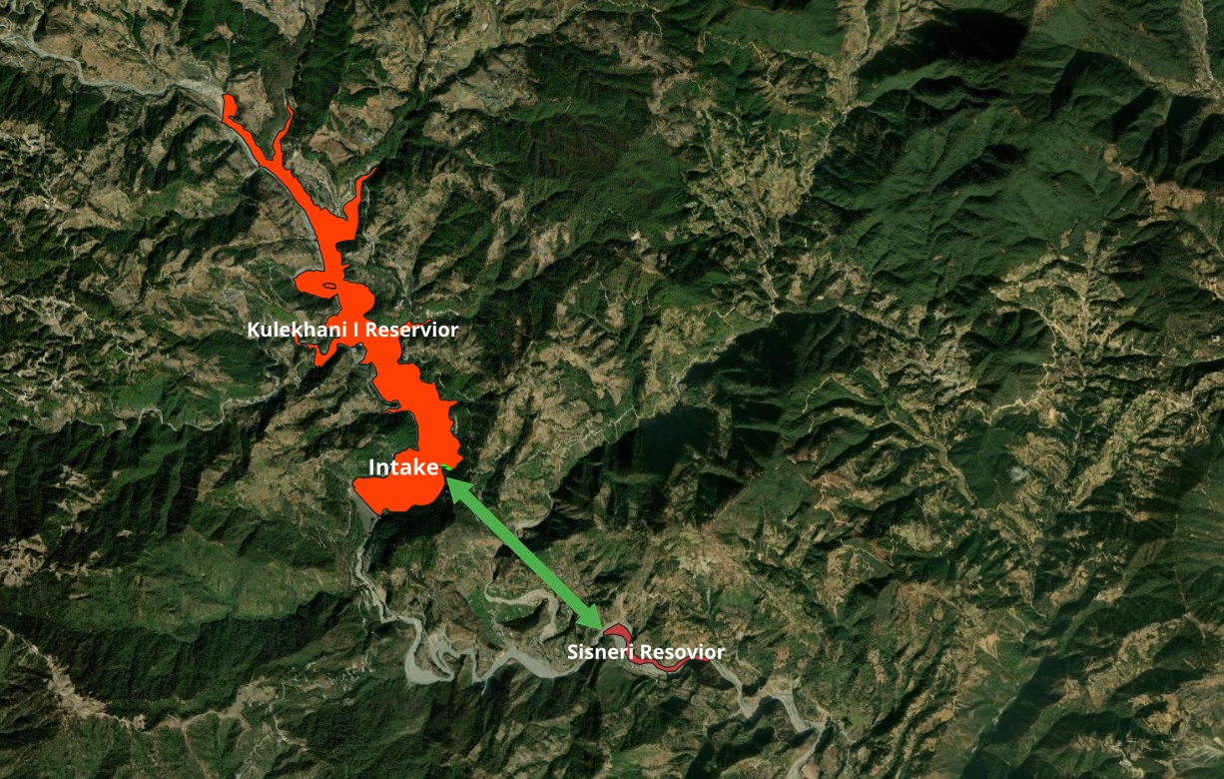
Case Study for Kulekhani-Sisneri Pumped Project
FIGURE 7 : General layout for Kulekhani Sisneri project

Slide 43
Output Specification of Kulekhani-Sisneri Project
Energy Storage | 610.46 MWh
Mean Gen Discharge | 118.52 m³/s
Mean Gross Head | 125 m
Nominal Tunnel Dia | 4.63 m
No. Tunnels | 1
Adjusted Tunnel Dia | 4.63 m
L/H | 17.6
Mean Gen Head loss | 22.05 m
Net Head @ Mean Gen Discharge | 102.94 m
Min Plant Gen Power (Firm Capacity) | 101.74
No. Units | 2
Unit Rating | 50.87 MW
Max Penstock Velocity | 5.95 m/s
Max Draft Tube Tunnel Velocity | 2.29 m/s
Penstock Dia | 3.55 m
Draft Tube Tunnel Dia | 5.73 m
Pump Time | 6 hr
FIGURE 8 : Output specification using cost modelling tool

Slide 44
CAPEX Estimation
CAPEX Element | 337 MW ($/kW) | 500 MW ($/kW) | 116 MW ($/kW) | PERT Estimation ($/kW)
Lower Reservoir | 204.21 | 423.7 | 113.1167 | 225.6094512
Waterways | 182.28 | 120 | 482.844 | 372.276017
Powerouse Civil | 131.36 | 70 | 207.7112 | 172.0341528
Electrical and Mechanical Cost | 525.44 | 750 | 704.8515 | 682.474309
Engineering Procurement and Construction cost | 253.4 | 379.1 | 660.0486 | 404.9747718
Owner Cost | 78.87 | 379.1 | 2066.5 | 460.179975
Total |  |  |  | 2317.548677
Estimation Class 5 Accuracy
Lower limit -20% to -50%
Upper limit +30 to + 100%
This value can be used for early feasibility study and concept screening

Slide 45
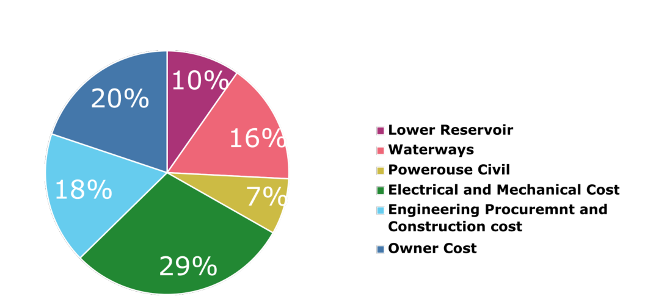
CAPEX Estimation of Kulekhani Sisneri Project
Total estimated CAPEX = 2317.55 USD/kW
FIGURE 9 : CAPEX breakdown for Kulekhani Sisneri Project

Slide 46
LCOE of Kulekhani Sisneri Project
Num (Grid) | 269488259.4
Den (Grid) | 3547866.824
LCOE from domestic Energy | 75.9578284 | $/MWh
Num (IEX) | 267783712.9
Den (IEX) | 3547866.824
LCOE from IEX | 75.47738576 | $/MWh
The LCOE for Competitive market is slightly lower than that of regulated market
With increase in renewable penetration the LCOE for competitive market is expected to decrease in future
Competitive market is more favorable for pumped storage hydro

Slide 47
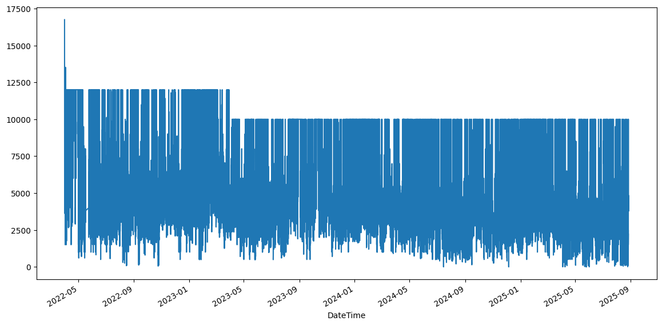
Optimum Scheduling for IEX Day Ahead Market
IEX market clearing prices from May 2022 to September 2025 was taken for analysis
FIGURE 10 : IEX Day Ahead Electricity Market Price from May 2022 onward

Slide 48
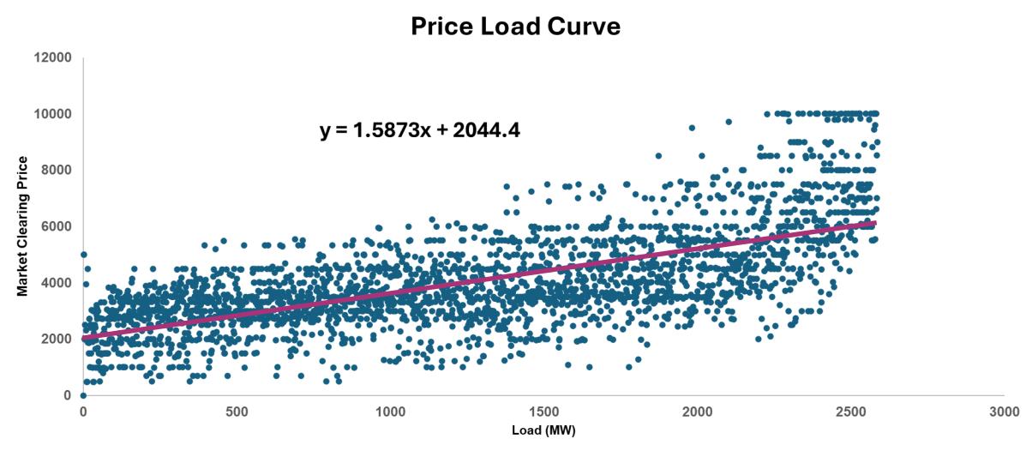
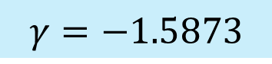
Optimum Scheduling for IEX Day Ahead Market
$$γ=−1.5873$$
FIGURE 11 : Price load sensitivity of IEX market for May 2025

Slide 49
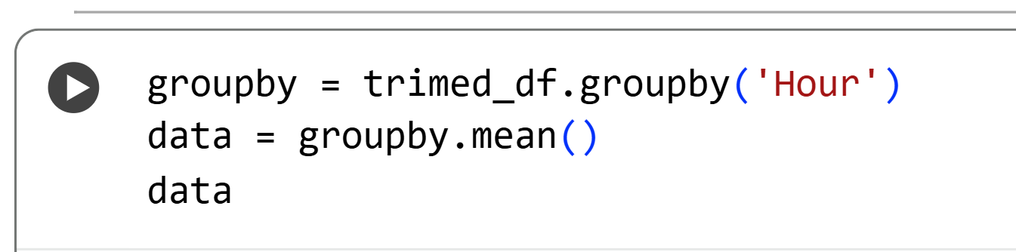
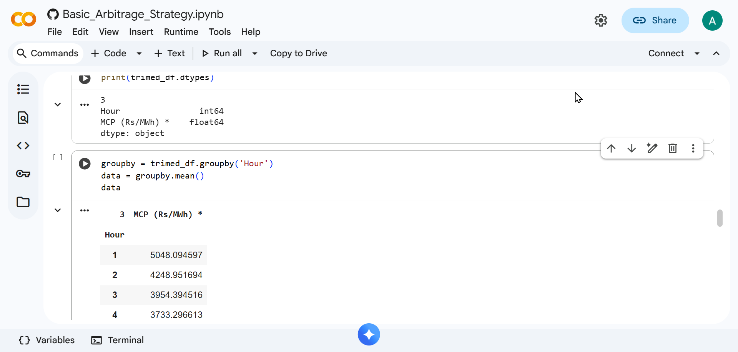
Optimum Scheduling for IEX Day Ahead Market
Simple forecasting method based on average of past data is performed in python

Slide 50
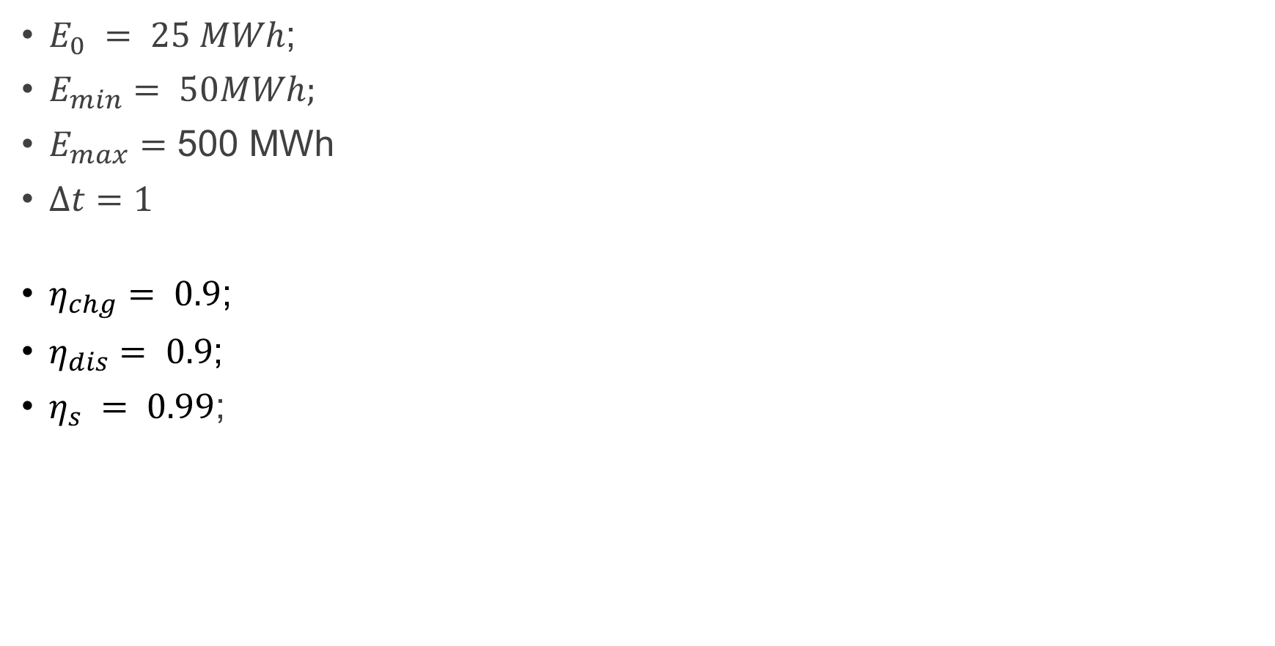
Optimum Scheduling for IEX Day Ahead Market
$E_{0} = 25 MWh$;
$E_{min}= 50MWh;$
$E_{max}=\text{500 }\text{MWh}⁡$
$Δt=1$
$η_{chg}= 0.9$;
$η_{dis}= 0.9$;
$η_{s} = 0.99$;
Constraints

Slide 51
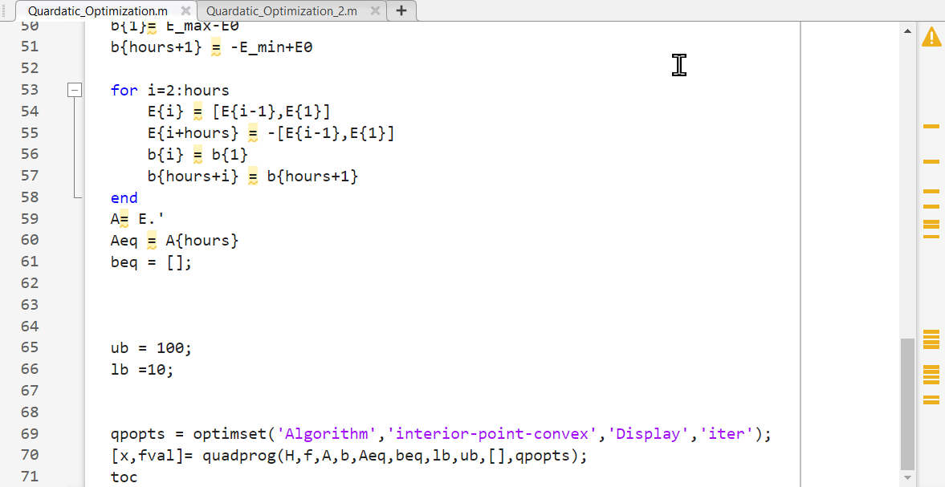
Optimum Scheduling for IEX Day Ahead Market

Slide 52
Optimum Schedule for Day Ahead Market in IEX
FIGURE : Obtained charging and discharging schedule using IEX data

Slide 53
Conclusion
An economic analysis of a pumped storage hydro project in Nepal, was performed
Offers insights into construction costs
Comparison of the economic competitiveness in both market based and regulated power systems
Identify potential revenue schemes

Slide 54
Conclusion
The economic evolution can guide policymakers, investors, and stakeholders in making decisions regarding the development of pumped storage hydro
With increasing renewables, in India Nepal can take advantages to make investment in Pumped storage hydro more feasible.

Slide 55
Recommendation and Future Work
Introducing additional variables such as holidays, weather conditions, and seasonal demand patterns into the forecasting model
Optimum scheduling of pumped storage hydro in real time market

Slide 56
References
[1] | S. Cohen, V. Ramasamy, and D. Inman, A Component-Level Bottom-Up Cost Model for Pumped Storage Hydropower, National Renewable Energy Laboratory, Golden, CO, NREL/TP-6A20-77022, 2020.
[2] | N. Zhao, Q. Wu, S. Huang, and Y. Wang, “Maximizing the revenue of energy storage participants in day-ahead and real-time markets,” IEEE Transactions on Sustainable Energy, vol. 6, no. 2, pp. 516–525, Apr. 2015.
[3] | A.Jirel, T. R. Bajracharya and M. M. Keitsch, “Integrating Solar PV with Pumped Hydro Storage in Nepal: A case study of Sisneri-Kulekhani pump storage project,” in Proc. 12th IOE Graduate Conference, Kathmandu, Nepal, Oct. 2022, pp. 1088-1097.
[4] | R. Sioshansi, P. Denholm, T. Jenkin and J. Weiss, “Estimating the value of electricity storage in PJM: Arbitrage and some welfare effects,” Energy Economics, vol. 31, no. 2, pp. 269-277, Mar. 2009.
[5] | Hydro-Electric Corporation (Entura), Pumped Hydro Cost Modelling, Cambridge, TAS, Australia, Dec. 2018

Slide 57
References
[6] | Nepal Electricity Authority, Annual Report 2024/2025, Kathmandu, Nepal, 2025.
[7] | Black & Veatch, Cost and Performance Data for Power Generation Technologies, prepared for the National Renewable Energy Laboratory (NREL), Overland Park, KS, USA, Feb. 2012.
[8] | K. Mongird, V. Fotedar, V. Viswanathan, V. Koritarov, P. Balducci, B. Hadjerioua, and J. Alam, Energy Storage Technology and Cost Characterization Report, Pacific Northwest National Laboratory (PNNL), Richland, WA, USA, Rep. PNNL-28866, July 2019.
[9] | N. K. Sah, M. Uprety, S. Bhandari, P. Kharel, S. Suman, and R. K. Maskey, “Prospects of Storage and Pumped-Storage Hydropower for Enhancing Integrated Nepal Power Systems,” Hydro Nepal: Journal of Water, Energy and Environment, vol. 15, pp. 37–41, Jul. 2014.
[10] | Himalayan Pumped Storage Hydropower to Support a Transition to Zero/Low Carbon Electricity Grids: Project Synthesis Report, The Australian National University, Fenner School of Environment & Society, Canberra ACT, Australia, AWP Activity No. 660129.77; ANU Q30100T4, Mar. 2024

Slide 58

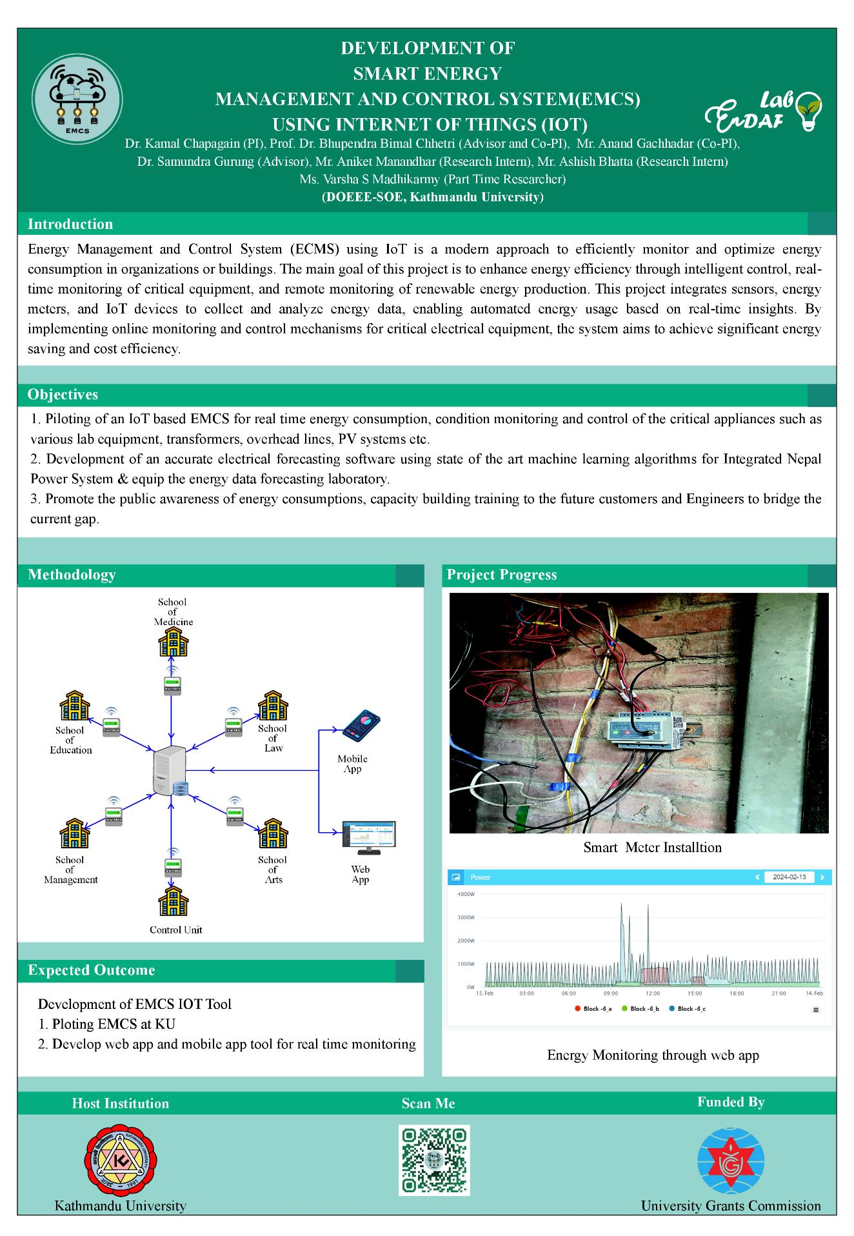

My 2 Year Experience in KU

Slide 59
Thank You for Listening!
For further information:
Ashish Bhatta
MEEPE 2023
bhattaashish907@gmail.com
Notes:
Final Slide [Fixed Format]

